Slide 1
Comparing Extrapolation Methods (2) Pulse Stretching and Gate Insertion
November 24, 2020
Results from Almost Thanksgiving Weekend!

Slide 2
Randomized Benchmarking
Same Procedure as shown in last week slides but now with 10^5 samples instead of 10^4
All qubits are initialized in the 0 state
Then we generate a circuit of n gates which add up to identity
Result should be all qubits in 0 state but practically, due to noise, that is dependent on number of gates in the circuit
The more gates, the more noise and hence less probability of getting the initial state
In the following slides, on top of the number of gates, we amplify noise using pulse stretching and gate insertion.
Ideally, extrapolated outcomes should imply that P(initial state) = 1

Slide 3
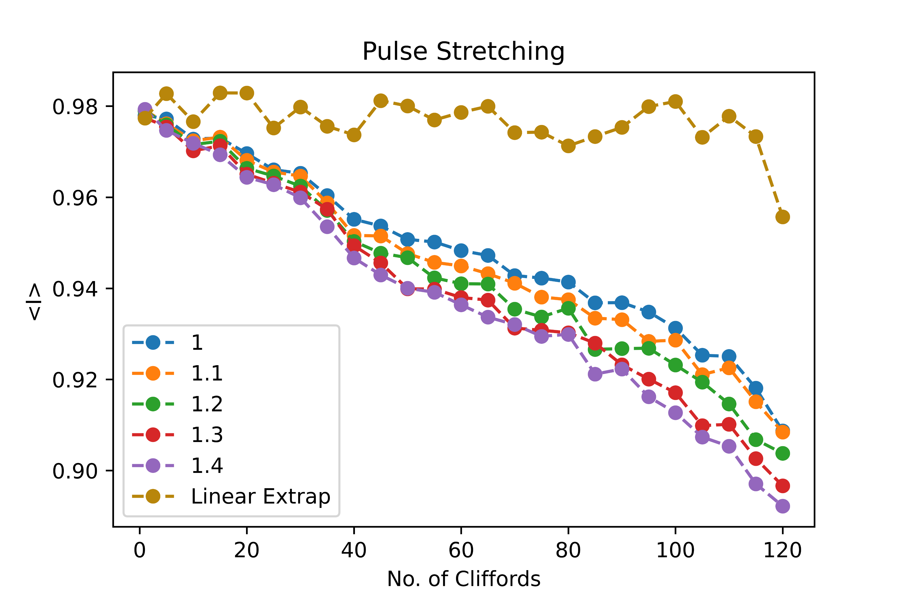
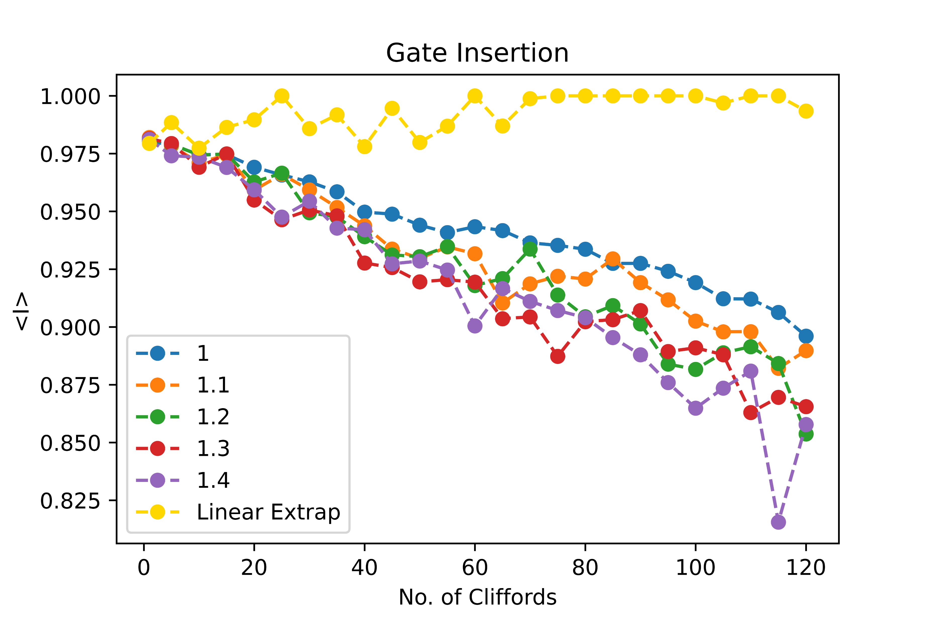
Single Qubit Randomized Benchmarking
Pulse Stretching
Gate Insertion

Slide 4
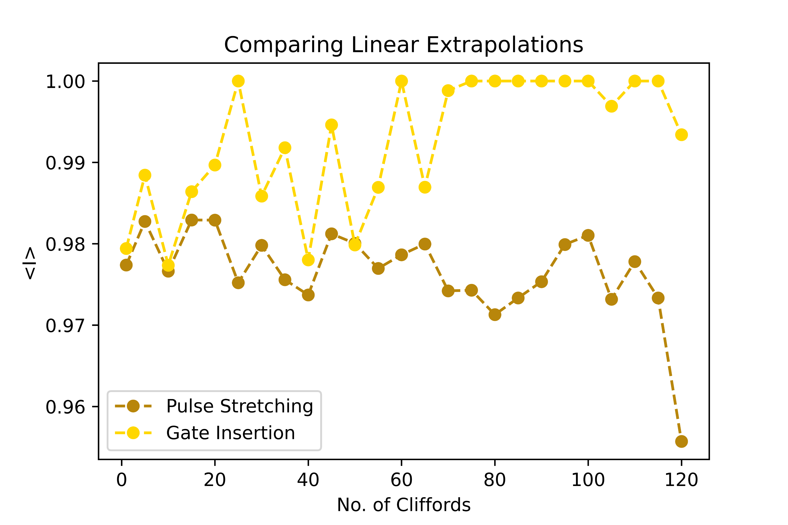
Comparing Extrapolations Single Qubit Data
Probabilities greater than 1 are set to 1
Only comparing linear extrapolation data because drastic fluctuations with high order polynomials + Richardson

Slide 5
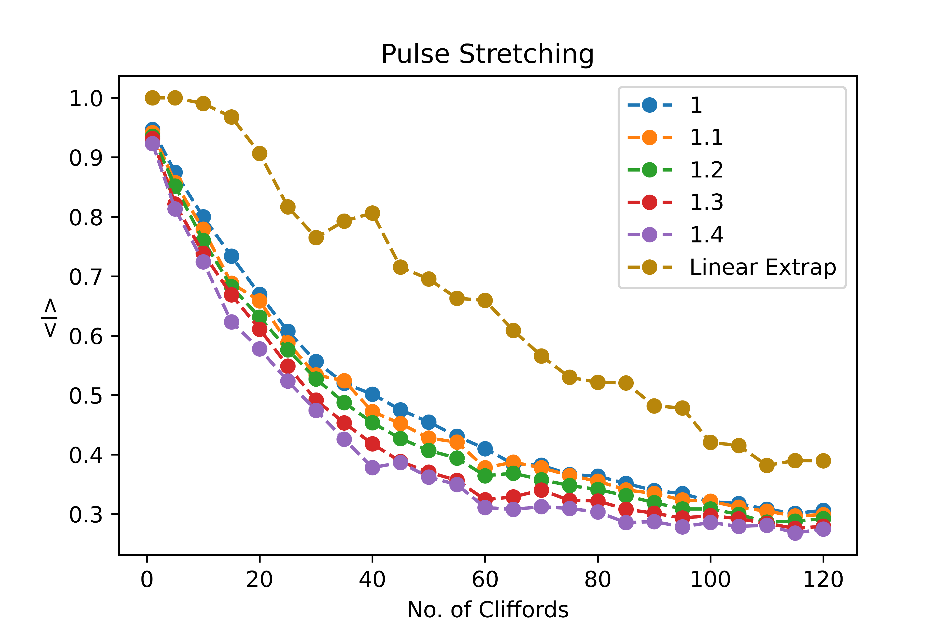
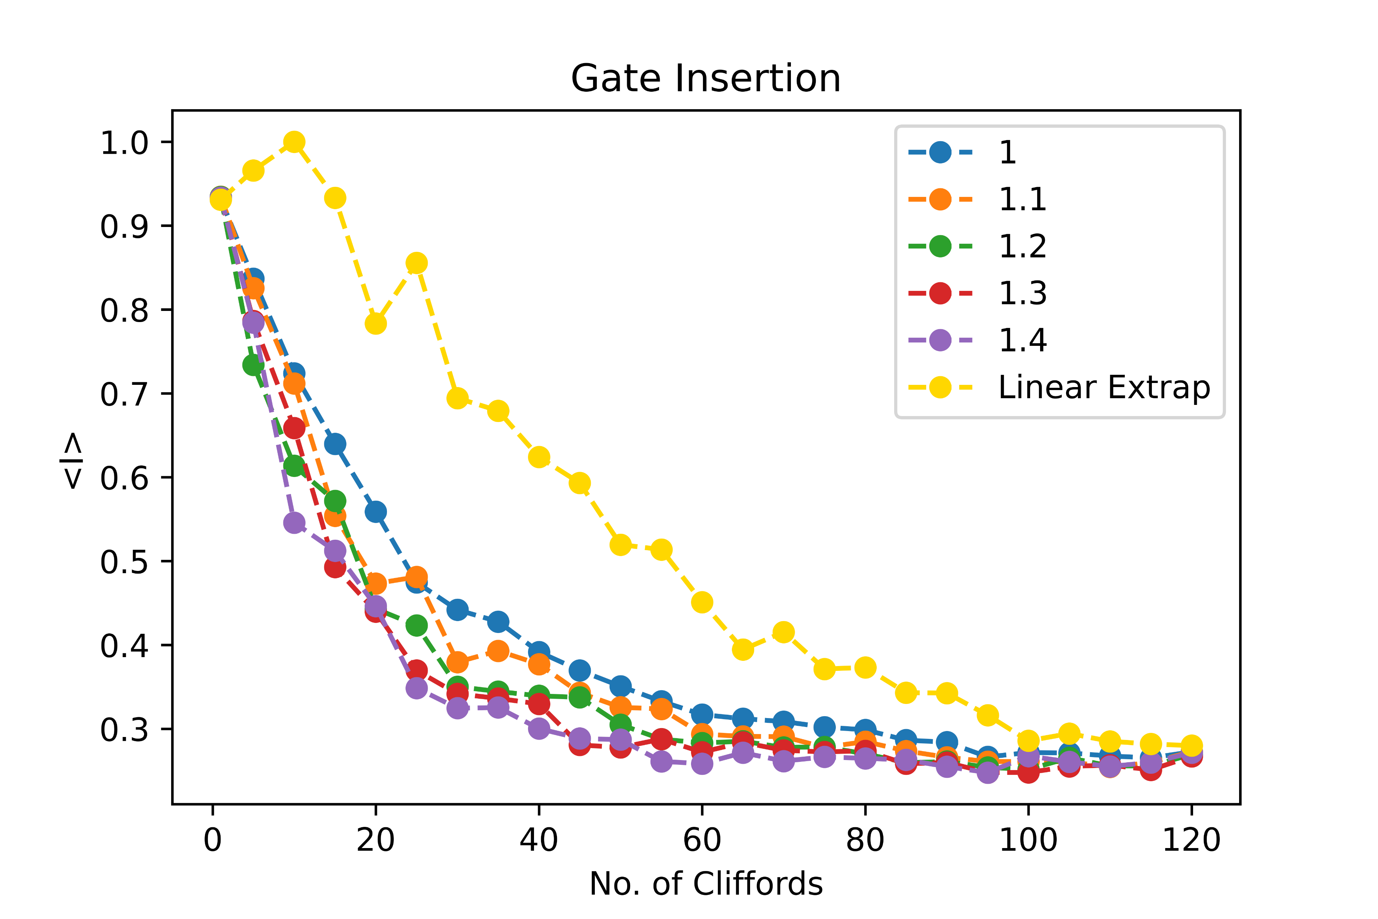
Two Qubit Randomized Benchmarking
Pulse Stretching
Gate Insertion
* The gate count as shown by x axis is representative of the circuit before it went through gate insertion procedure

Slide 6
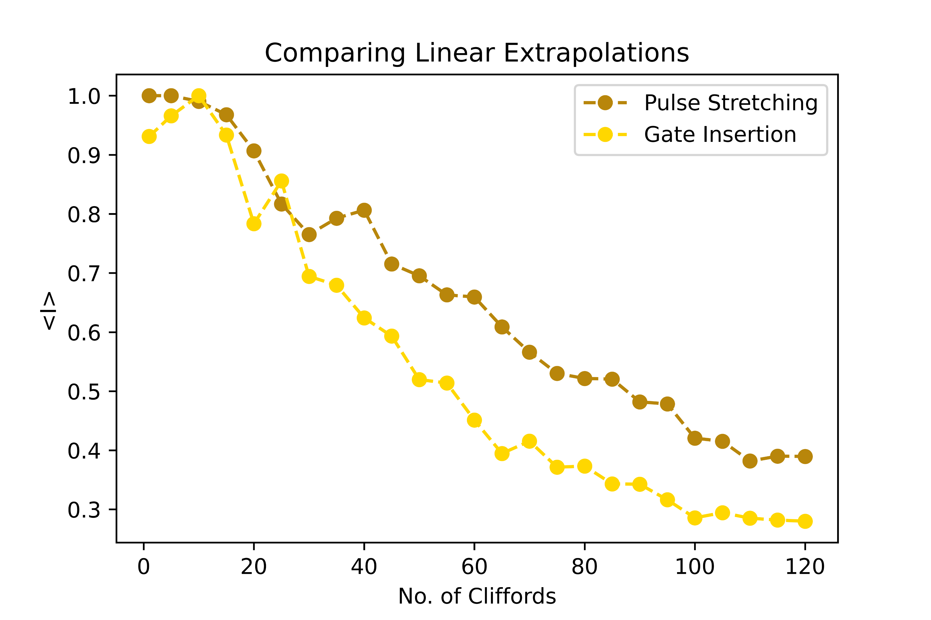
Comparing Extrapolations Two Qubit Data
Probabilities greater than 1 are set to 1
Only comparing linear extrapolation data because drastic fluctuations with high order polynomials + Richardson
Now it seems that pulse is better, especially for higher depth circuits, than gate insertion

Slide 7
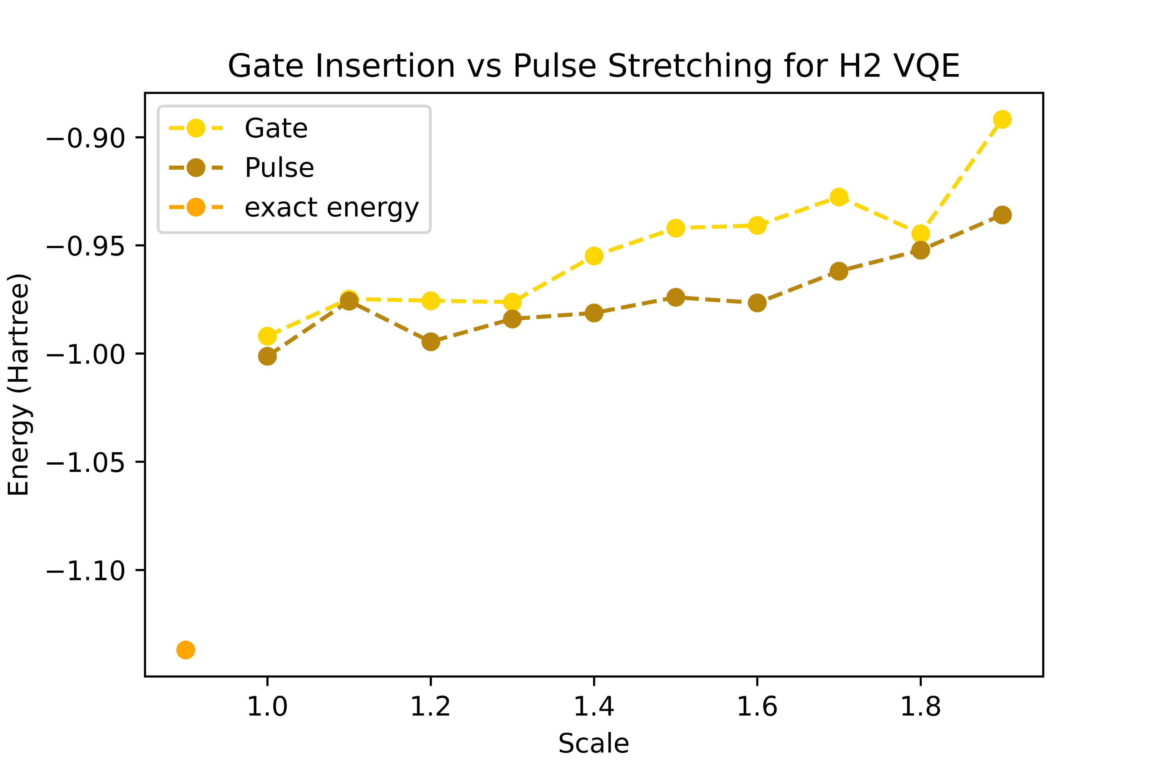
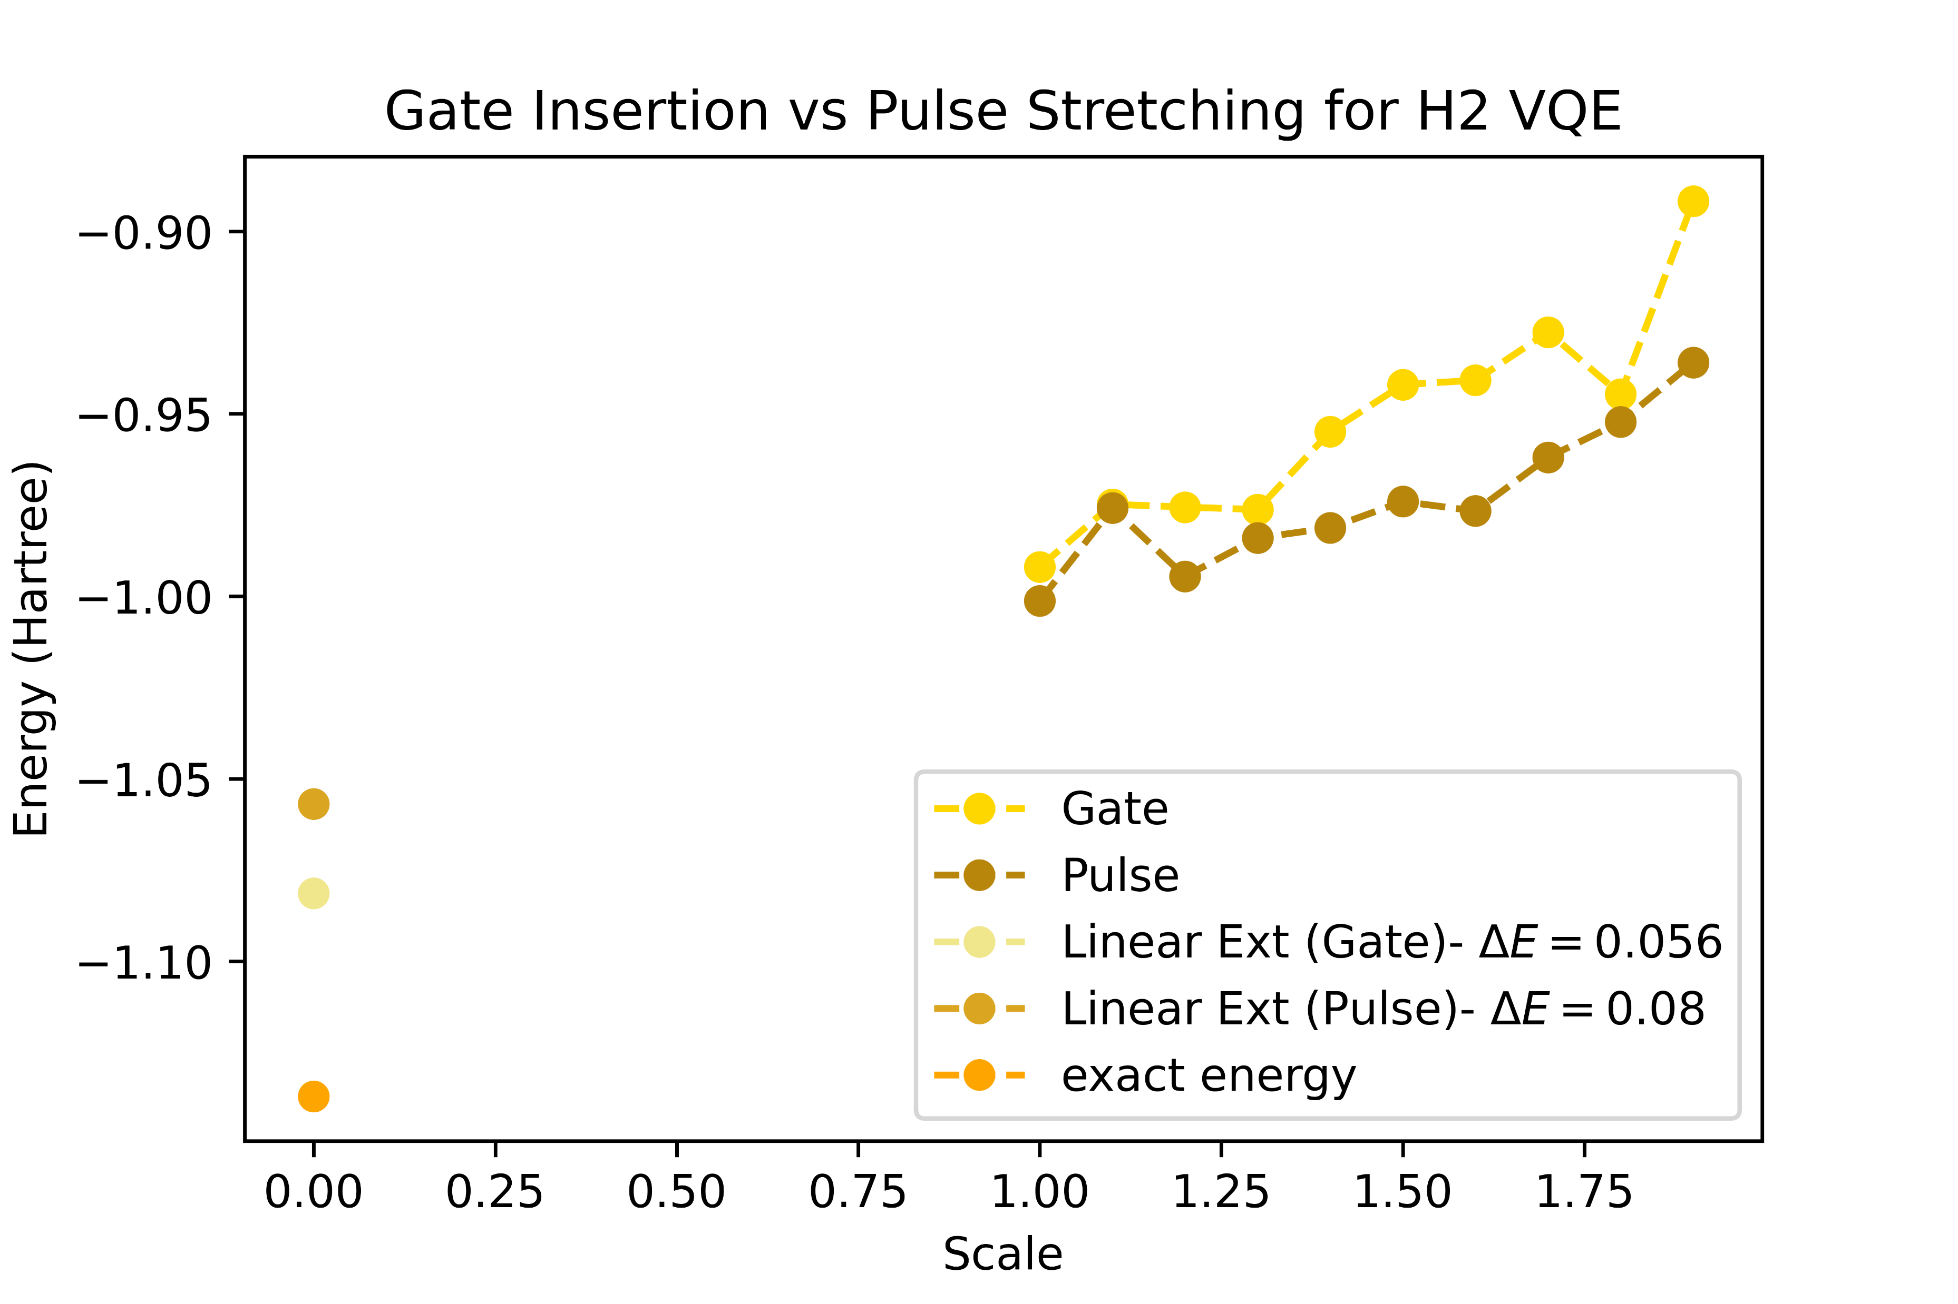

VQE on $H_{2}$molecule Optimized Parameters on Casablanca Noise Model
Raw Data
With Linear Extrapolation
Hopefully, applying readout error mitigation, these differences get within chemical 0.001 H!

